Slide 1
MDS 560 Session 5

Slide 2
Important Notification
Note: Next session we meet on Wednesday evening May 6th starting at 7:00 p.m

Slide 3
Review of Homework
Wanted to see evidence of cleansing with Turbo Prep—discuss choices made—automatic acceptance of defaults may not be what you want:
Missing values=0, average, min or max—default is average
Let’s examine
Good to see awareness that different models produced different results:
Performance
Variable Importance (pay attentions to signs of coefficients: example inventory in dataset 4)
Biggest Issue with Dataset 4 was variable selection; potential problems with some work centers. You want actionable variables in your model that are not simply proxies of the dependent variable. Avoid kitchen sink approach.
Fixing late delivery would also help profitability. Plus pricing an issue.
Let’s Explore

Slide 4
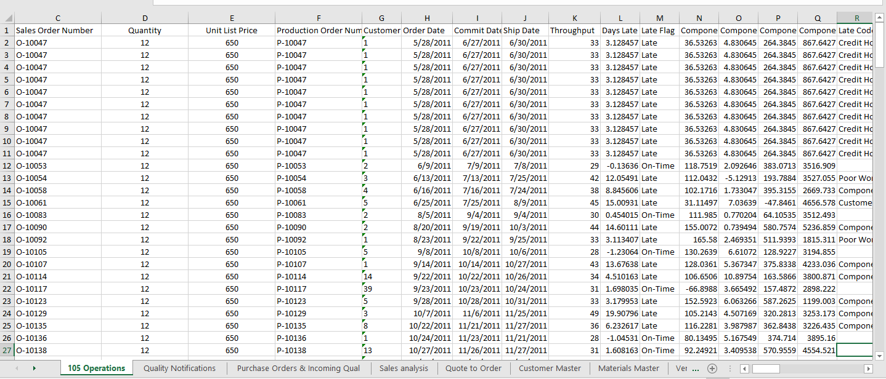
Result of a Query

Slide 5
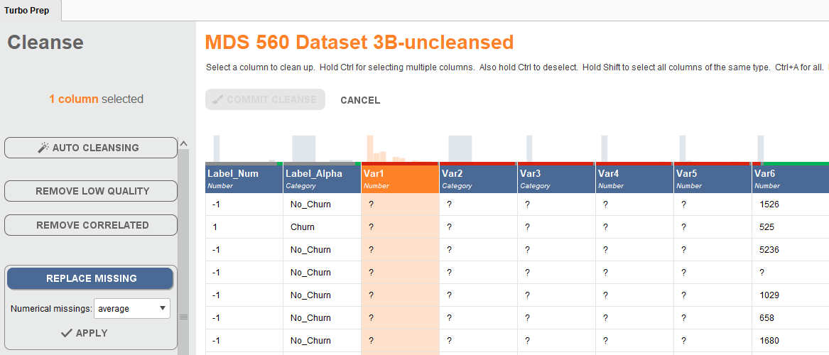
The Choice Made for Data Cleansing Need to be Deliberate
Blindly Accepting Defaults is not a Good Idea

Slide 6
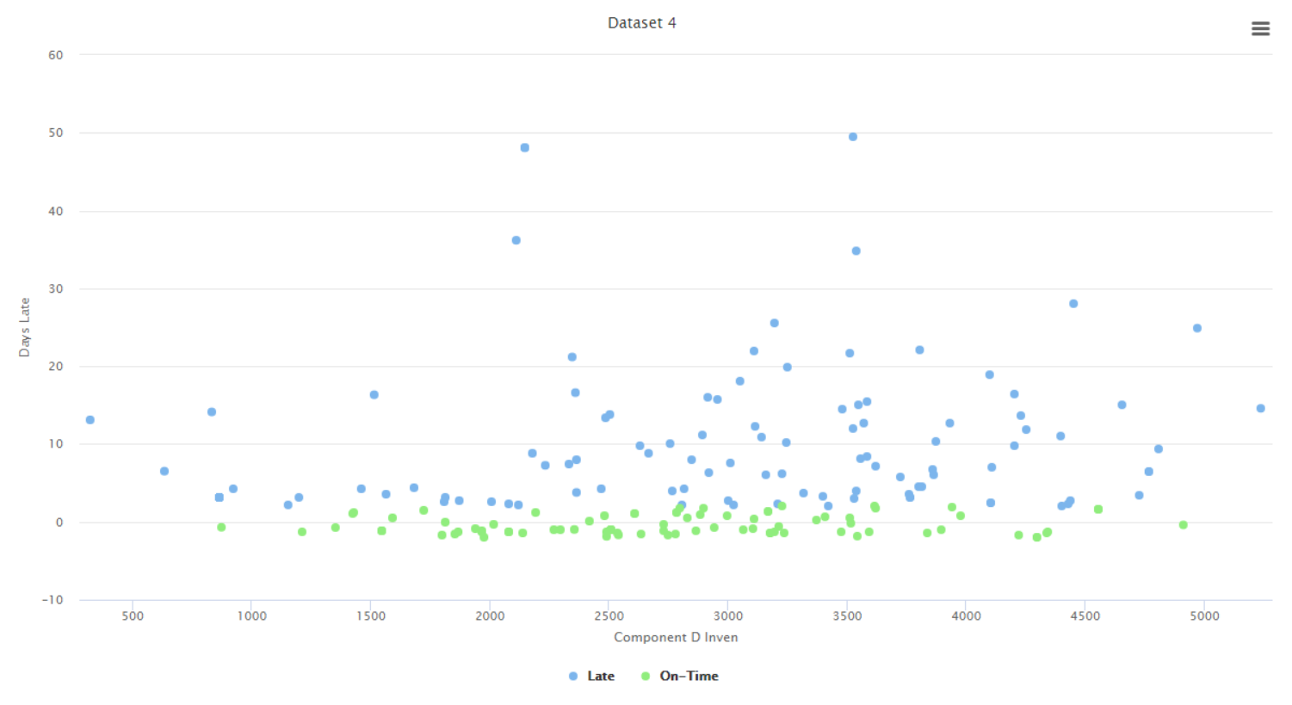
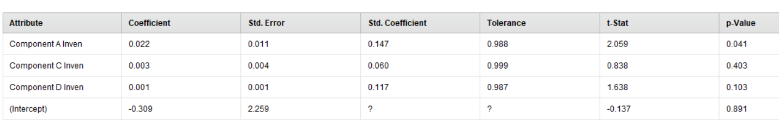
Inventory has the wrong sign to match theory.

Slide 7
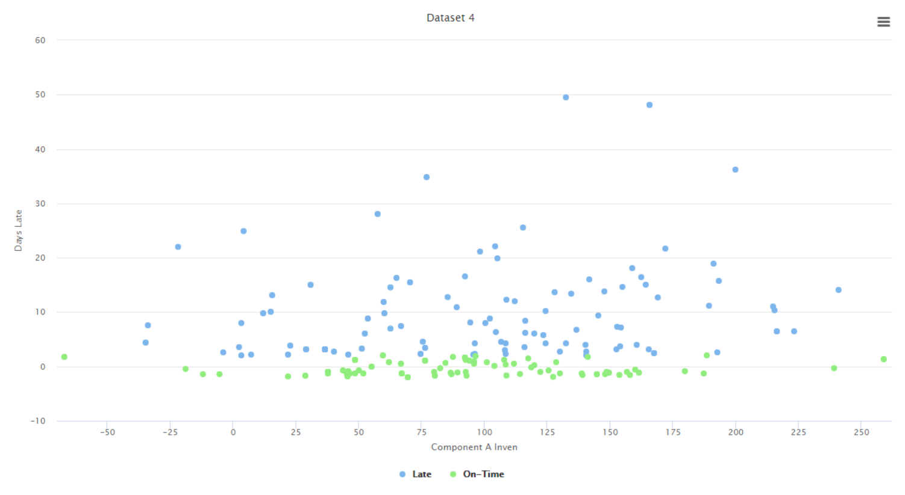

Slide 8
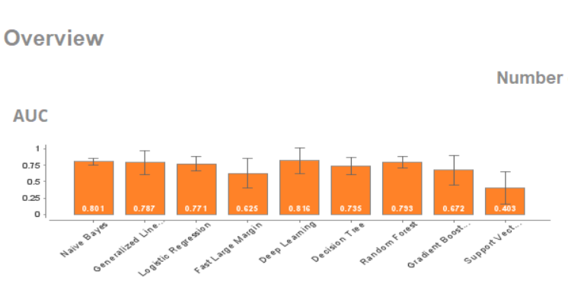
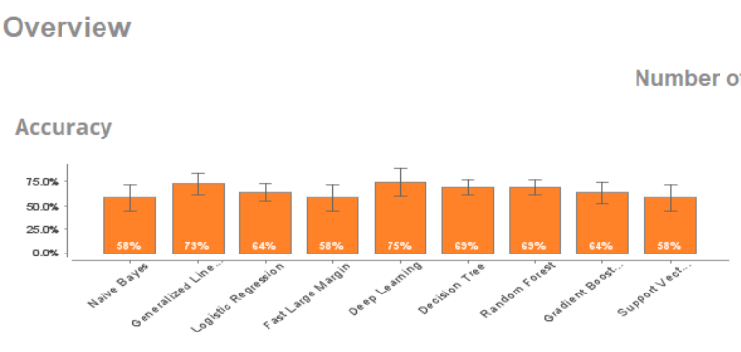
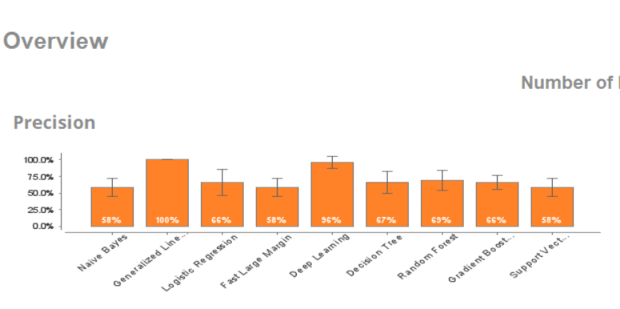
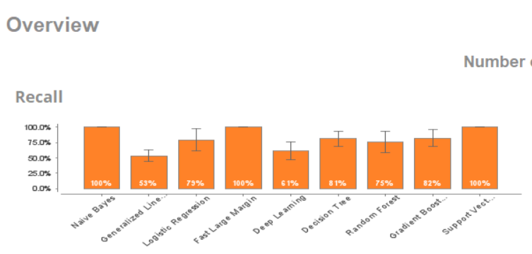
OTD

Slide 9
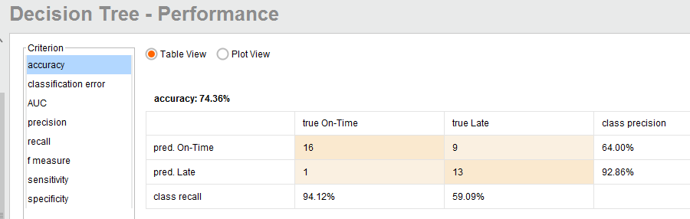
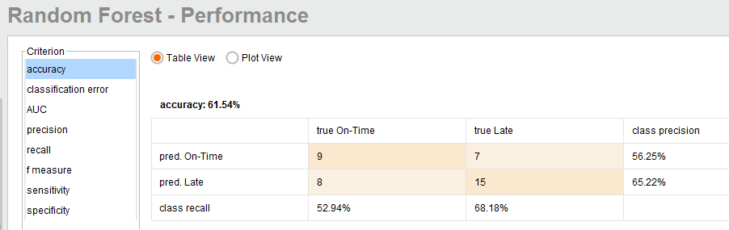

Slide 10
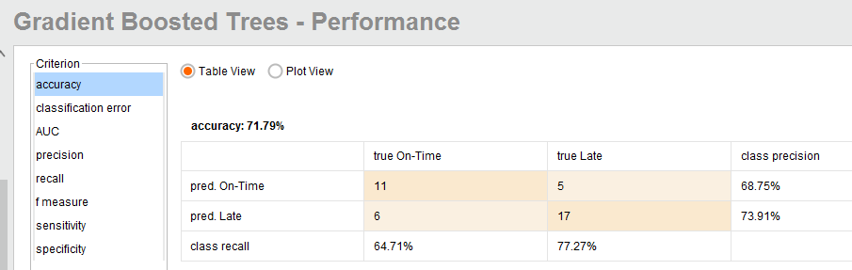

Slide 11
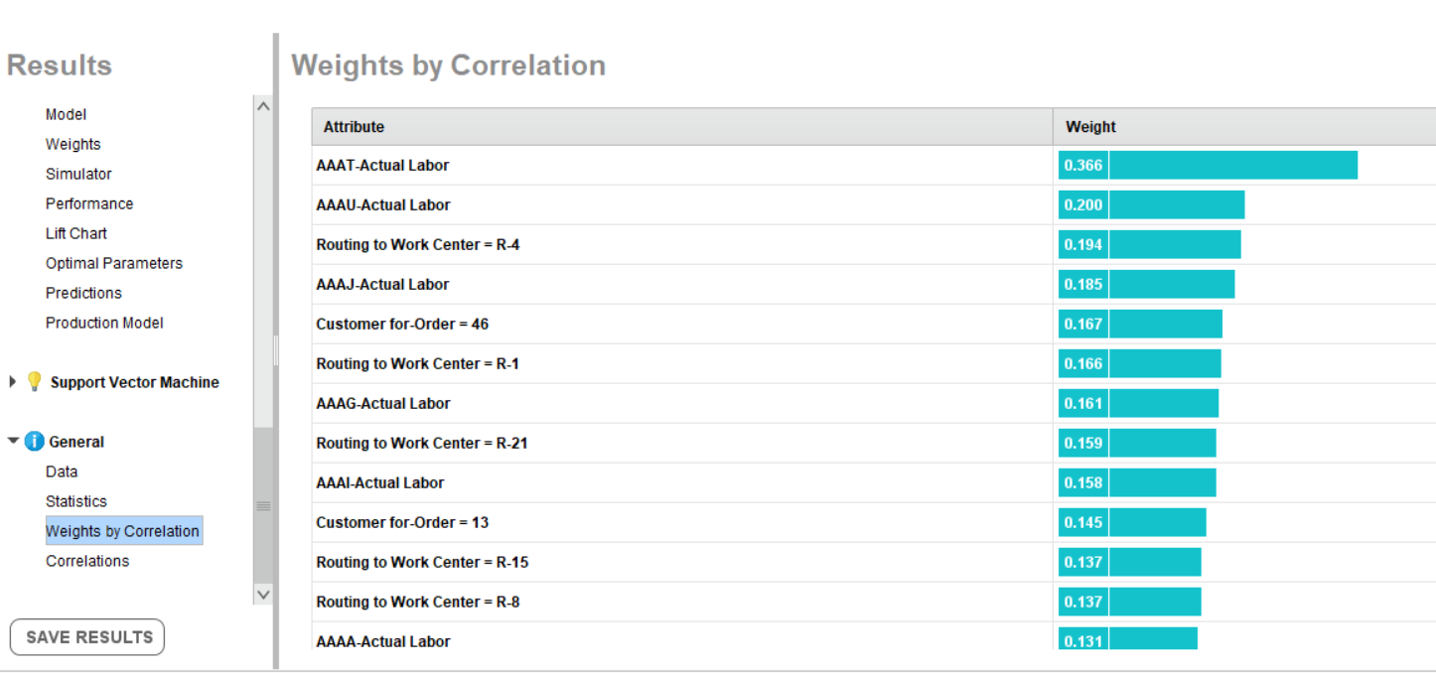

Slide 12
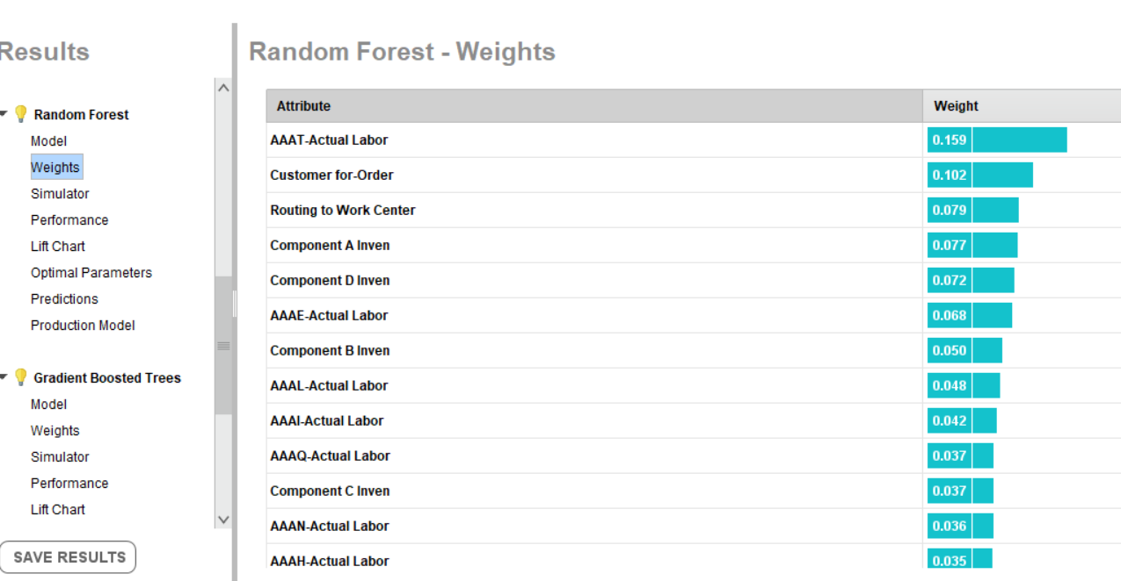

Slide 13
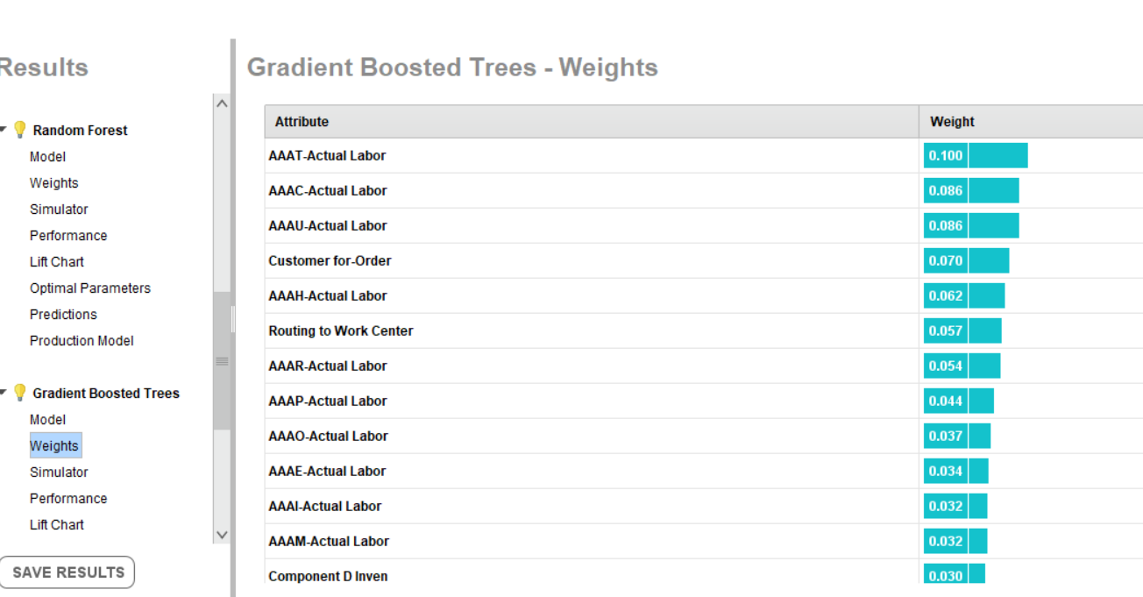

Slide 14
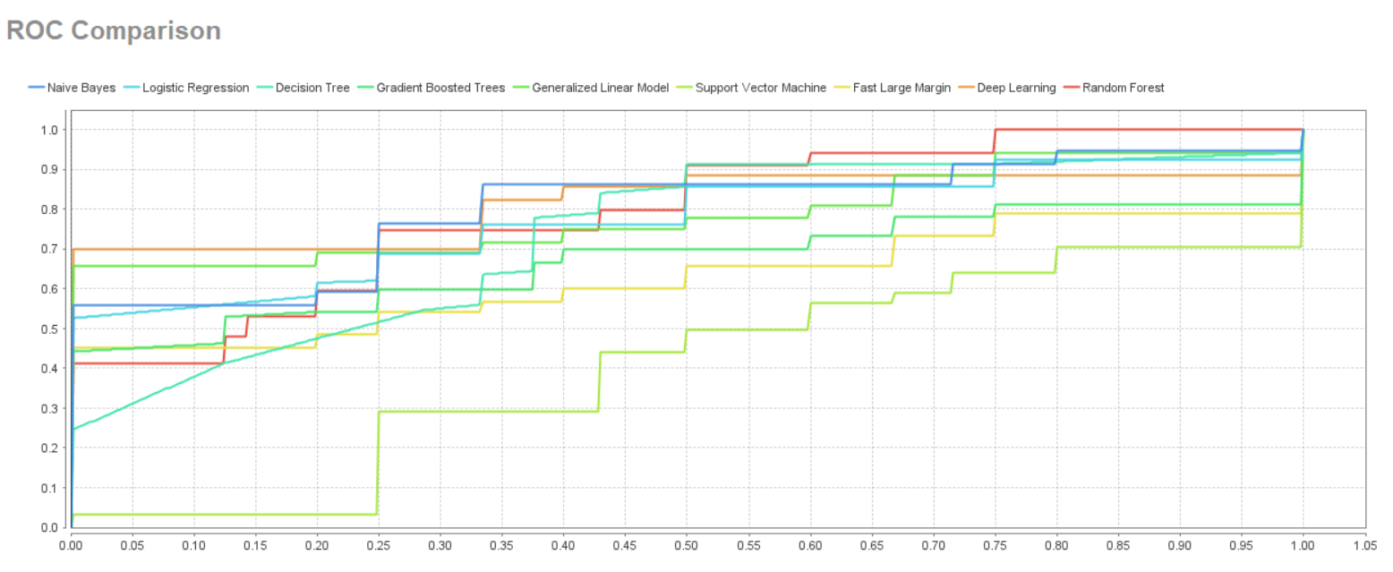

Slide 15
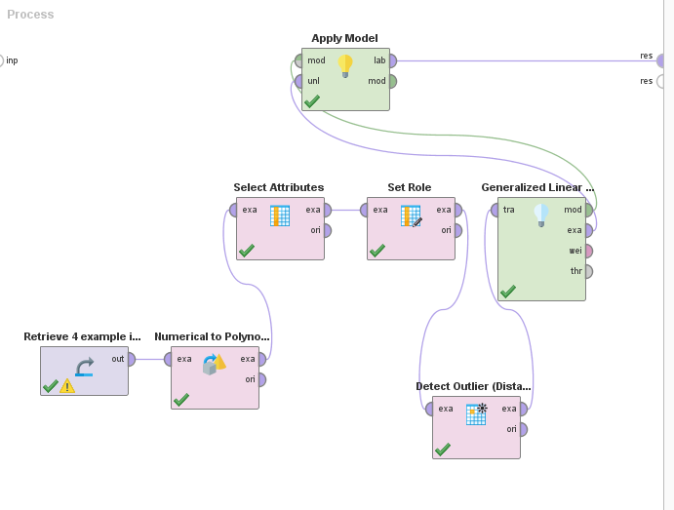
Outliers Should Be Considered When Using Linear Models
Important to Keep In for linear models

Slide 16
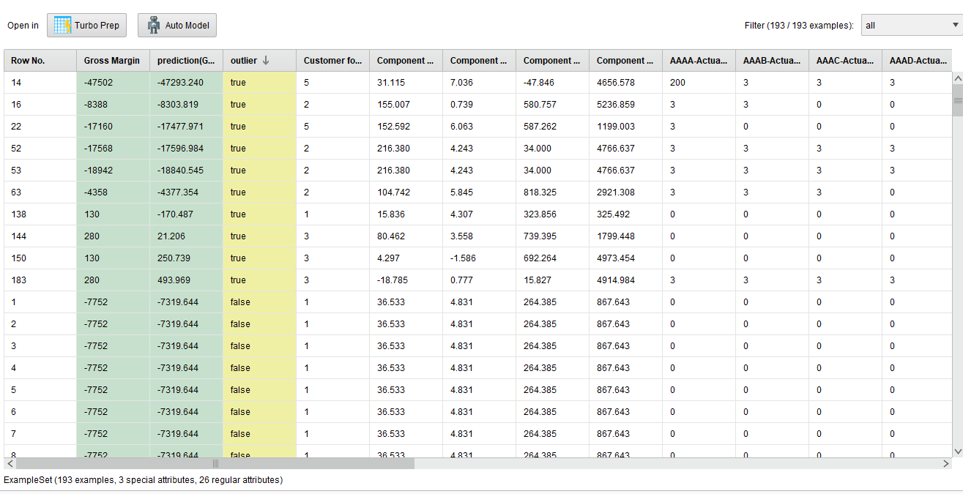

Slide 17
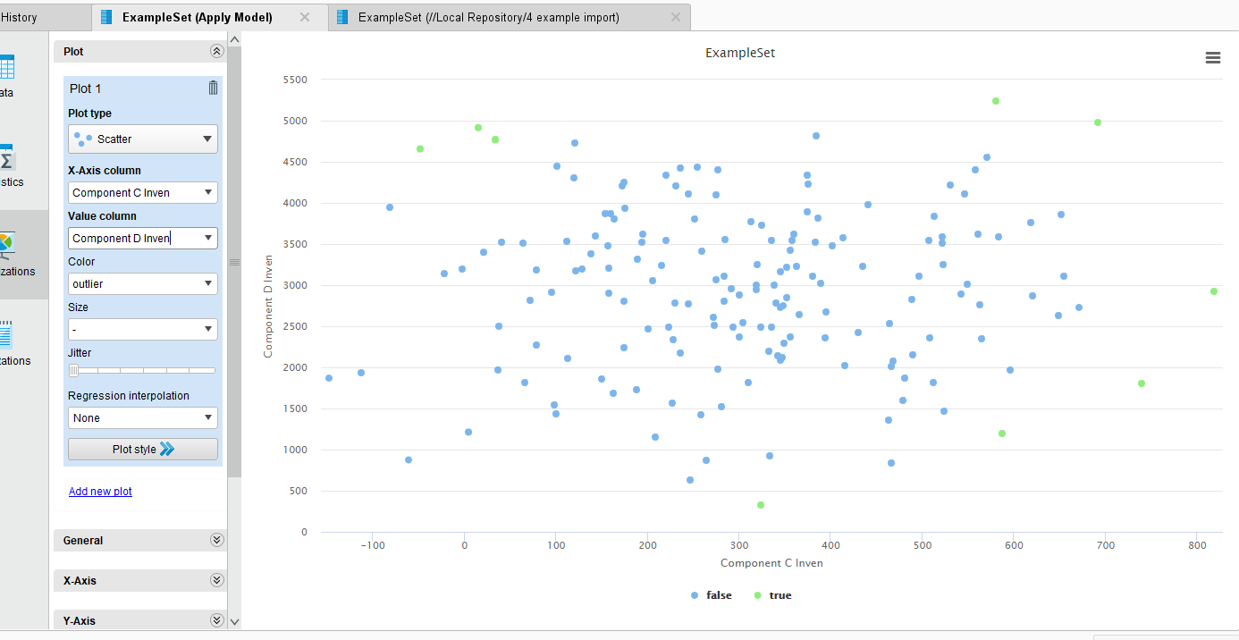

Slide 18
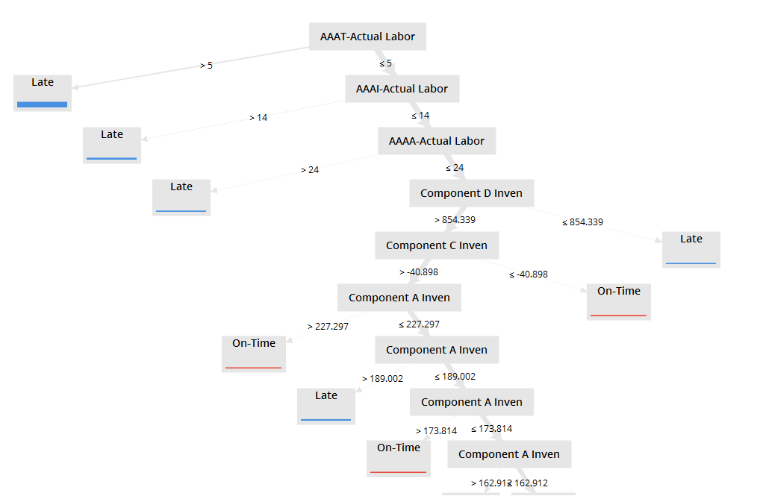
Your analysis Triggers the “five why’s”

Slide 19
Using The Five Why’s with Dataset 4
Value Add
Customers Complaining---Why?
45% on time delivery—Why?
Specific Work Centers—AAAT etc---Too Much Time—Why?
Rework Hours—Why?
Change of Assembly Specification---Why?
New EPA Regulation----ABC123
Your analysis
Your Engaging the business
Result:
Need to change labor standard
Need to change lead time quotations to customers
Need to change pricing
A data science solution
Note: You are going deeper in your analysis than standard KPI reporting.
You are not just using analytics to report the KPI problem, you are using analytics to solve the KPI problem.

Slide 20
Using The Five Why’s with Dataset 4
Value Add
Customers Complaining---Why?
45% on time delivery—Why?
Specific Work Centers—AAAT etc---Too Much Time—Why?
Rework Hours—Why?
Change of Assembly Specification---Why?
New EPA Regulation----ABC123
Your analysis
Your Engaging the business
Poor profitability--Why?
High freight premiums—Why?
45% on time delivery—Why?
….
….
Poor profitability—Why?
High Labor Costs---Why?
Specific Work Centers—AAAT etc---Too Much Time—Why?
Change of Assembly Specification---Why?
New EPA Regulation----ABC123
Need to change labor standard
Need to change lead time quotations to customers
Need to change pricing

Slide 21
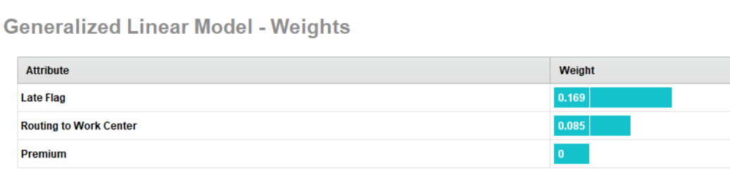
Profitability Suggests That Late Delivery and Low Profitability Are Related
Machine Learning Models Do Not Work Well With Accounting Identities.

Slide 22
Peirce’s Trichotomy of the Scientific Method
As Self-Correcting Cycles Leading to the “Truth”
Multiple
Hypotheses
Abductive
Reasoning
Begin Next Cycle with Convergence on “Truth”
What are Testable Conclusions About Other Phenomenon That Must Be Reached For Each Hypothesis if True?
Controlled Experiments Based Upon Samples From a Population
Explanatory
Hypotheses
Experience
What Must
Happen If True?
Deductive
Reasoning
Begin Research
Assess Results of Application and Adjust Hypotheses
A Question
Sufficient Accuracy Reached to Take Action
Elimination
of False Hypotheses
(retroduction)
Test Predictive
Models
Execute Actions
Inductive
Reasoning
Assess Accuracy
reflects imaginative interpretation of results.
Economics Plays a Role in Sufficiency Decision.

Slide 23
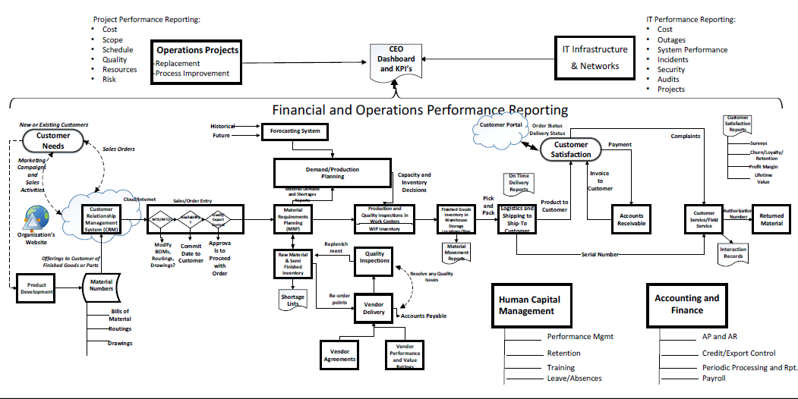
Nearly All Business Systems Collect Time Stamped Transaction Flows or Documented Interactions Between People (Roles), Goods , Services Departments, etc.

Slide 24
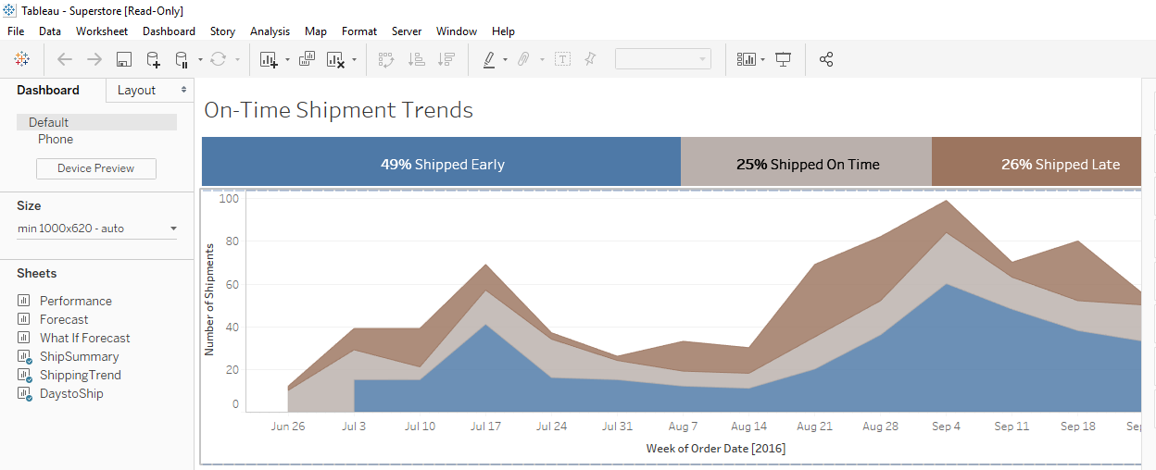
Common Format of KPI’s

Slide 25
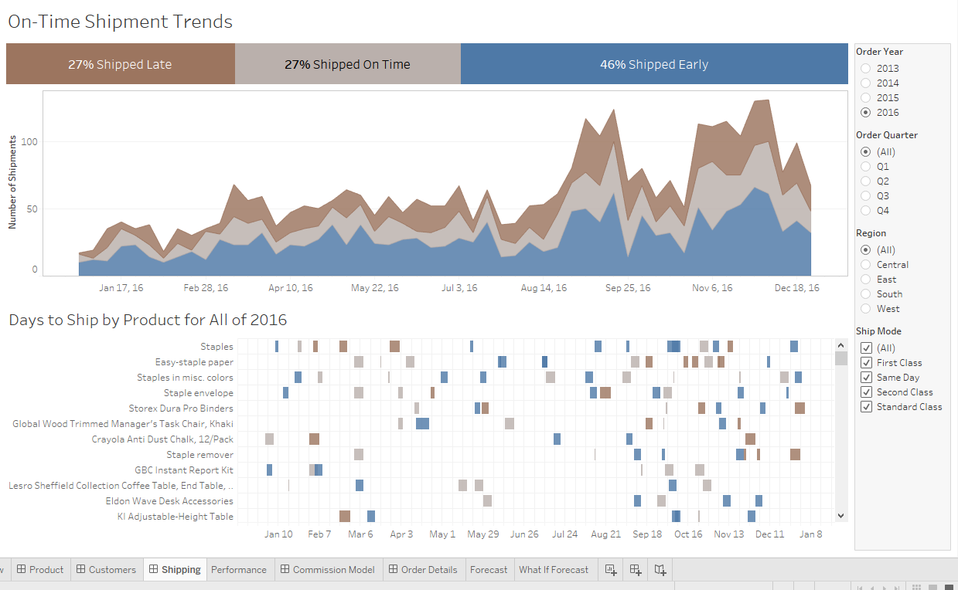

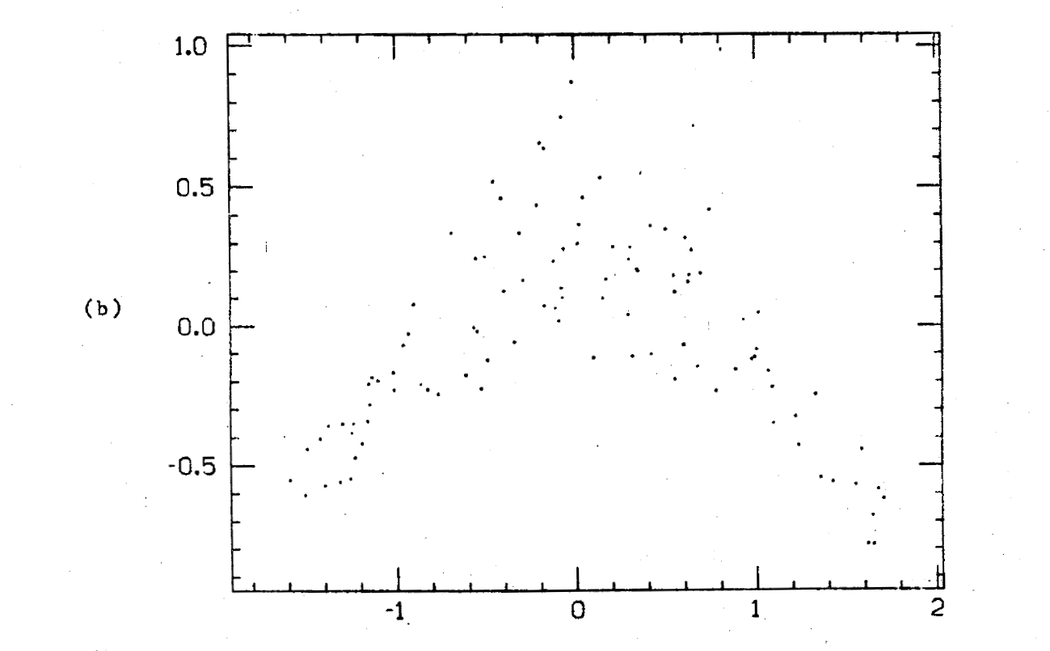

Big Picture Clarification
Observable
Process
Process Behavior
Efficiency and/or Effectiveness
KPI
Database
Metrics give us insights toward control of the process

Slide 26
Observable
Machine Learning Helps Identify Relationships of Variables
KPI
Data
Process
Model Selection Strategy
Predefined Structure or let data define structure
The data itself—how the point cloud looks
The performance of the model (ROC, cross validation, hold outs, etc)
VIPs make sense
The Underlying, Unobservable True Statistical Model that Generates the Data
Unobservable

Slide 27
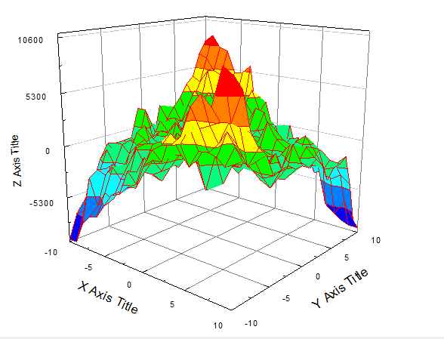
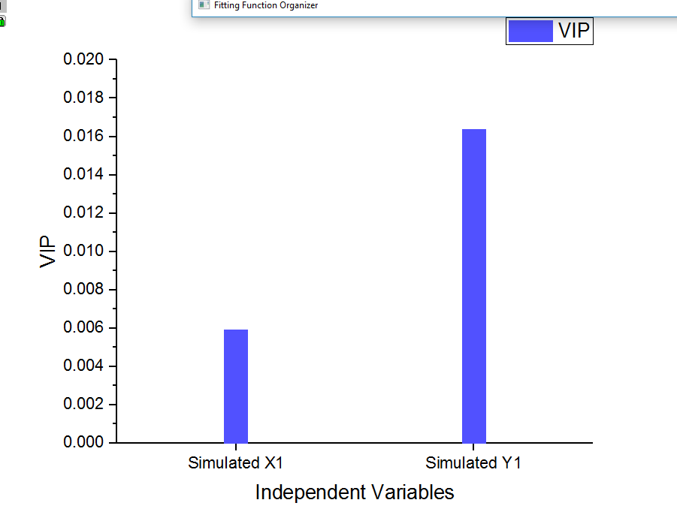
Observable
KPI
Process
Data
Drive organizational changes to optimize objectives
Model Based Upon Optimization Algorithm
Feature Weights
+
The Underlying, Unobservable True Statistical Model that Generates the Data
Unobservable
Model Approximates
Predict/Explain/Test

Slide 28
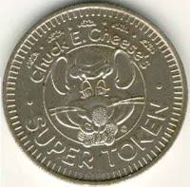
The SIPOC Framework Remains Key
Your Company
Sales & Market
HCM
Delivery/ Returns
Supplier’s Supplier
Make/Ops
Customer
Customer’s
Customer
Supplier
Source
Finance
IT
Common KPI’s
Loyalty
Growth
Quality
Delivery
Inventory
Productivity
$
Often the “Token Counter” Approach is a Useful Starting Point. This is foundational to process mining.
This is a variation of the APICS SCOR framework.

Slide 29
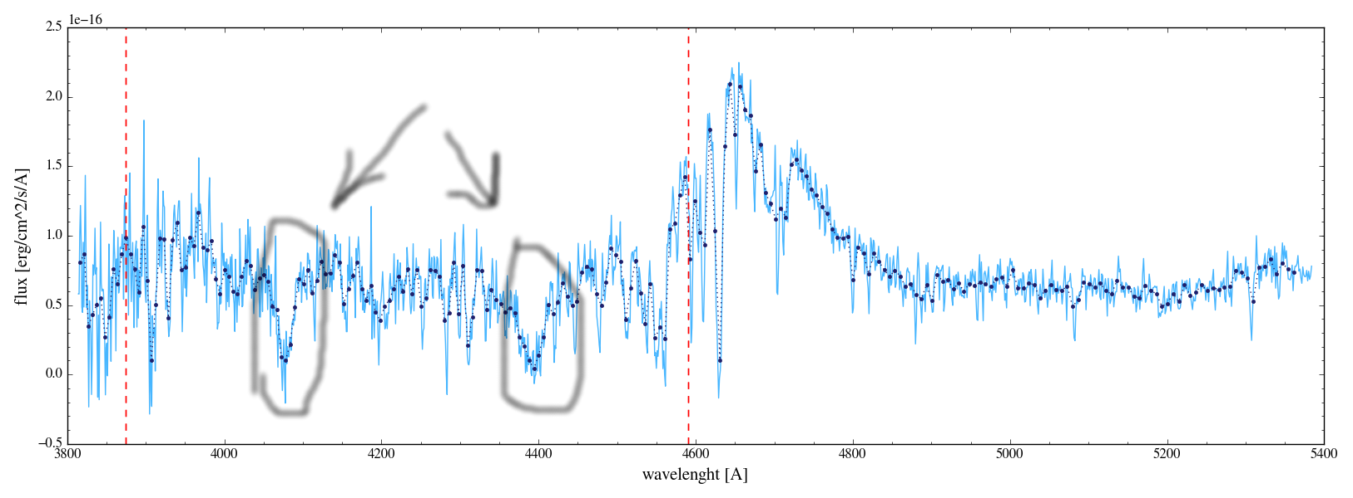
From a Process Perspective
We Have Events, Interactions and Material Movements
Process
Input
Output
Supplier
Customer
Process Performance Indicator

Slide 30
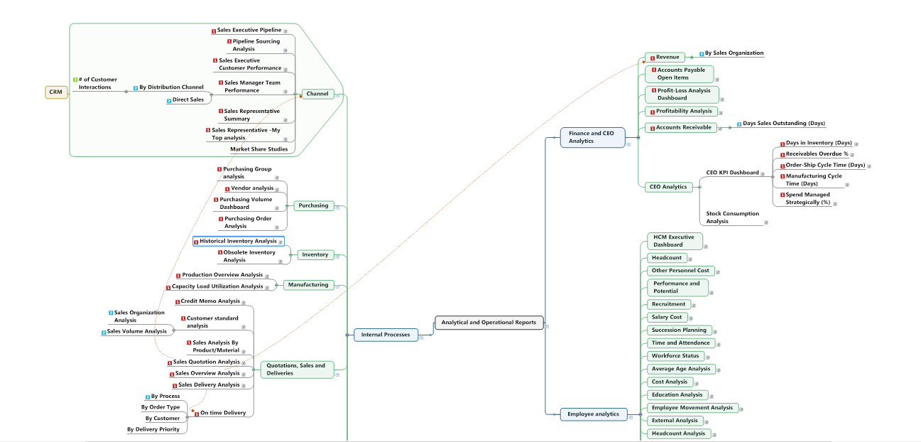
Partial View of Common Enterprise Analytics—FROM SAP

Slide 31
The CRISP Life Cycle Is Actually Two Life Cycles
Objectives
Production
Data and Process Mining
Unit Test and UAT
Data Discovery and Algorithm Development
Machine Learning
Solution Deployment
Device
Tested
Code (Typically C, C+)

Slide 32
Deploy to Production a Tool For Providing Accurate Lead Times to Customers Using Throughput as Dependent Variable

Slide 33
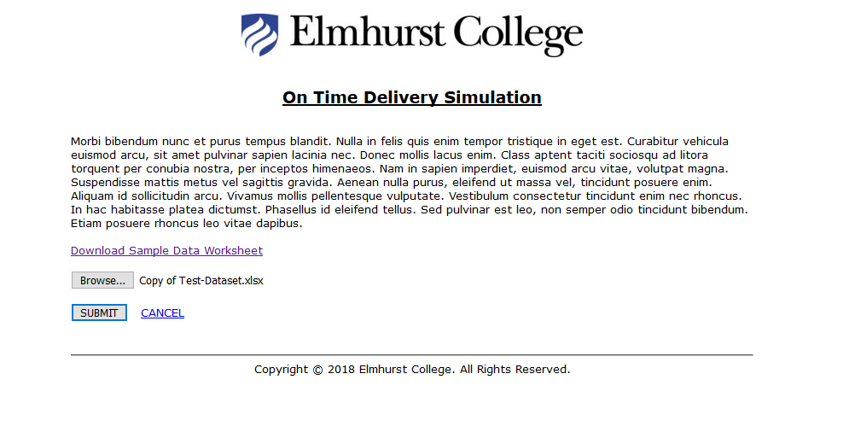
http://mds.elmhurst.edu/

Slide 34
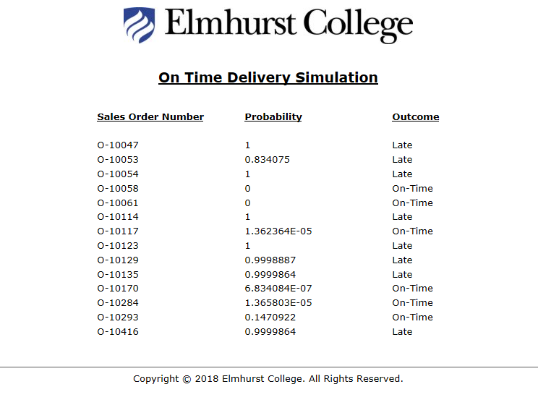

Slide 35
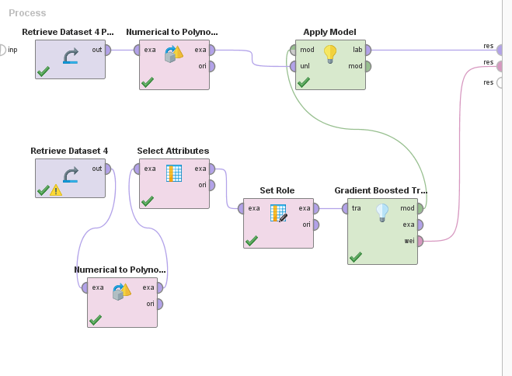
Estimated Lead Times for Quotation to Customers
Production dataset
Training dataset

Slide 36
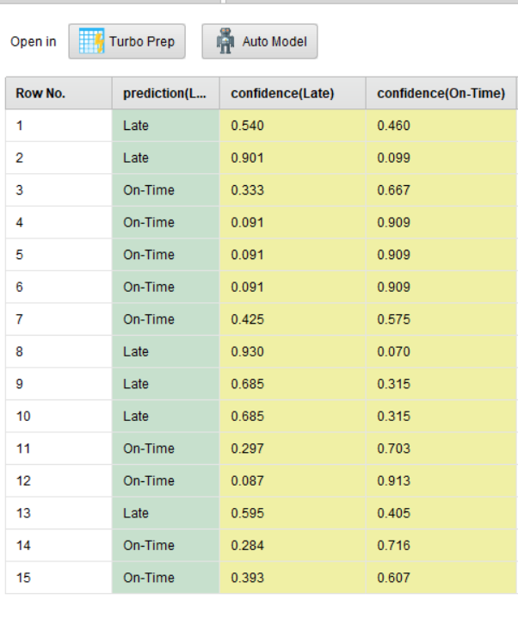

Slide 37
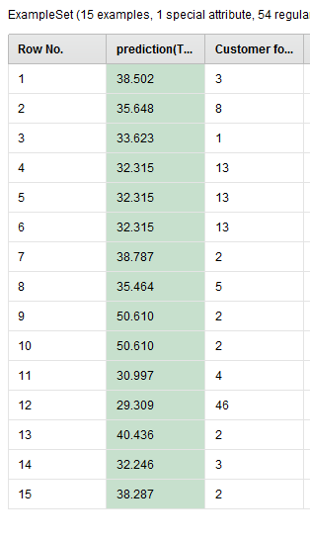
Output from the Deployed Production Model Enables to give more realistic lead time quotations to customers.
This will be your discussion question for the week. Set it up and comment on results.

Slide 38
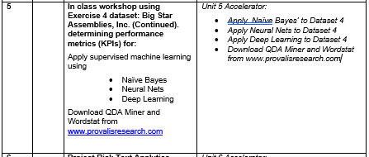
Suppose now that we have learned the “causes” of variation in our Y variable (label). We may now wish to focus on predictions of classifications only. So we may want to use models that are most closely associate with pattern recognition (e.g. images, text and speech).
Text allows us to do both.
Support Vectors

Slide 39
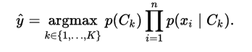
Bayes’ Theorem
Naïve Bayes’ Classifier makes assumption that all X variable are independent.
It is a multiplicative model of likelihood ratios rather than an additive model
But if you take logarithms, it becomes additive.
The classification with the highest predicted probability score, wins.
P(C_{k}|X)=p(X|C_{k}) p (C_{k})
P(X)
prior * likelihood
Posterior=
evidence
Let’s go to the Golf Dataset in Rapidminer.
Also, visit Rapidminer video
https://www.bing.com/videos/search?q=naive+bayes+rapidminer+video&view=detail&mid=451C577DF1B7C4096589451C577DF1B7C4096589&FORM=VIRE

Slide 40
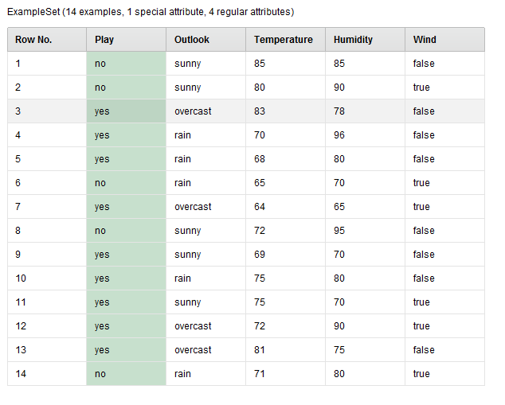

Slide 41
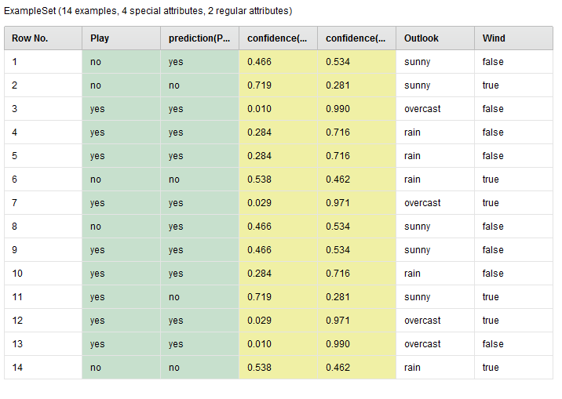

Slide 42
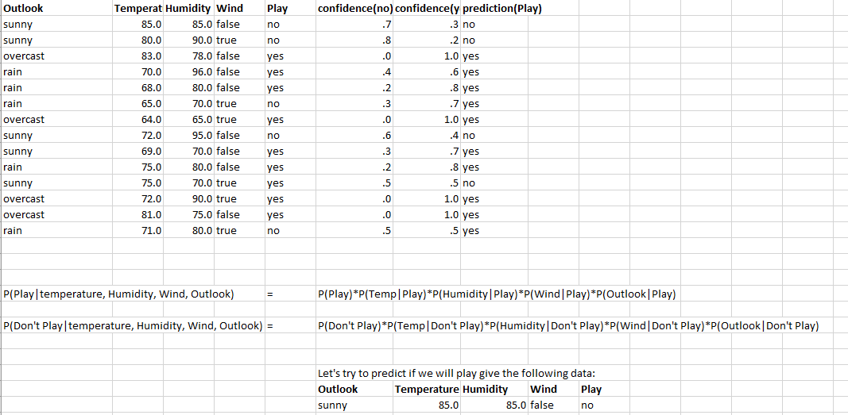
Naïve Bayes assumes independence of predictors

Slide 43
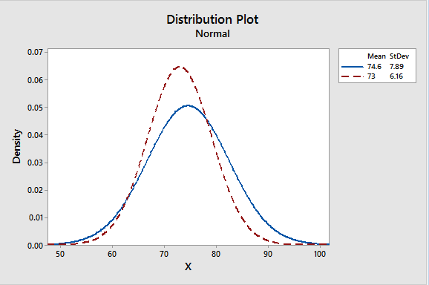
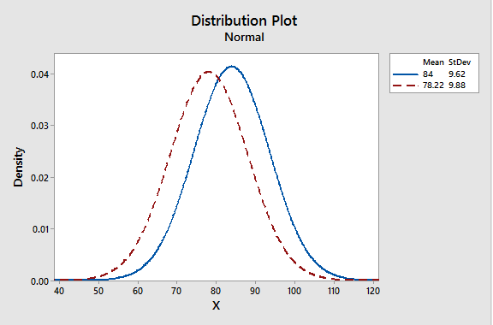
Likelihoods and Probabilities
Play
Don’t Play
Don’t Play
Play
85
85
Temperature
Humidity
Odds .025 to .011- in favor of not playing or P(Playing)= 0.30
Odds .041 to .032-→in favor of not playing or P( Playing)= 0.44

Slide 44
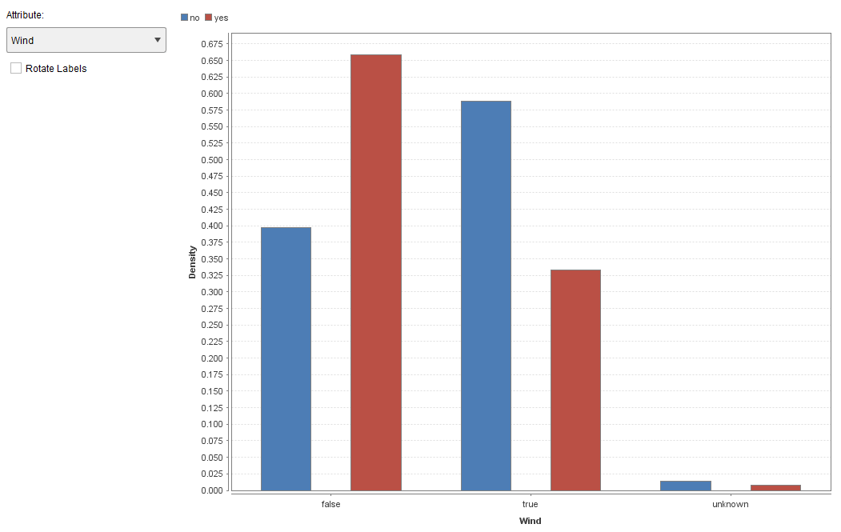
Odds are in favor of playing on a non windy day by
0.65 to .40 giving a probability in favor of playing p= 0.61

Slide 45
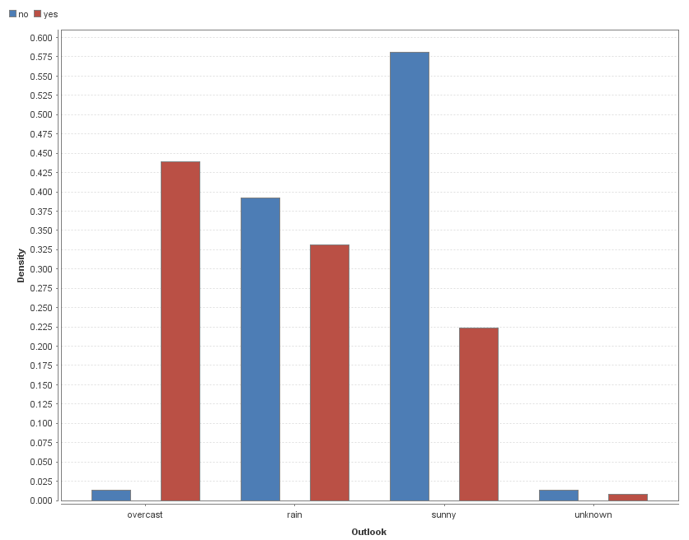
Odds are in favor of not playing on a sunny day by
0.575 to .225 giving a probability of playing p= 0.28

Slide 46
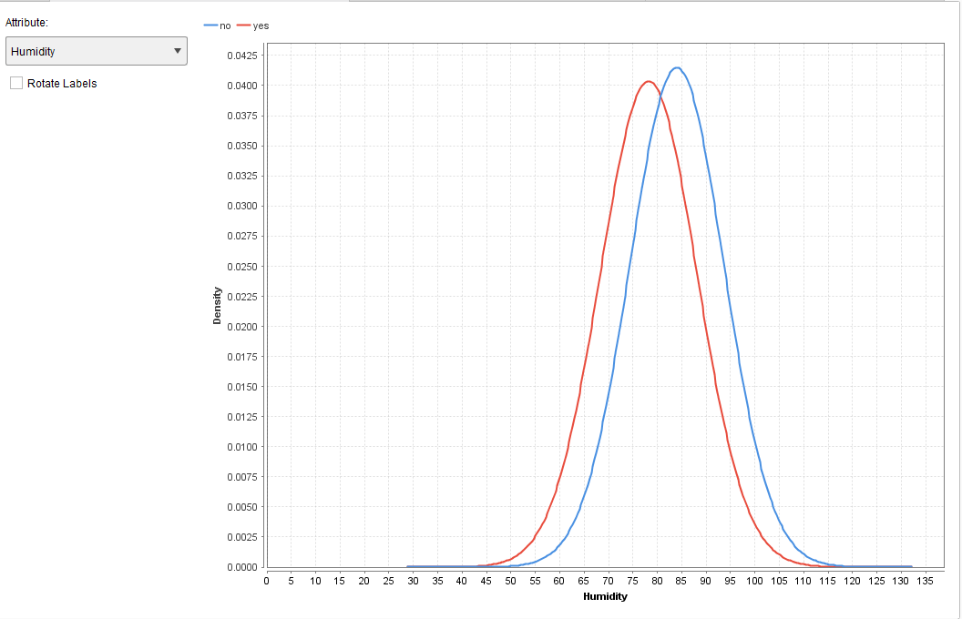

Slide 47
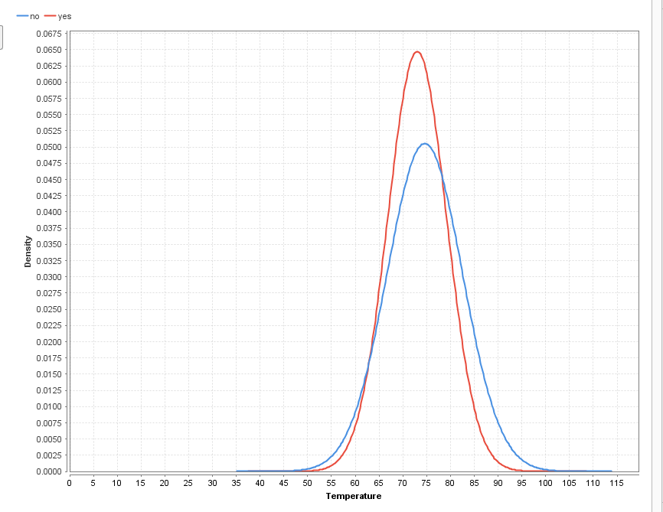

Slide 48
So given the assumption of conditional independence of all X’s the joint probability of playing is based upon the chain calculations of four evidence probability calculations and,
Calculating playing 0.3*.44*.61*.28=.022 * Prior(9/14)=0.014
Calculating not playing 0.7*.56*.39*.72=.111 *Prior (5/14)=0.039
Since P(evidence) is equal for both arguments, we could drop the P(evidence) and still Arg Max: not playing wins over playing. Therefore prediction is not playing that day for the test observation.
Probability of not playing=0.039/(0.014+0.039)=0.73
Many times analysts use natural logarithms to make terms additive.

Slide 49
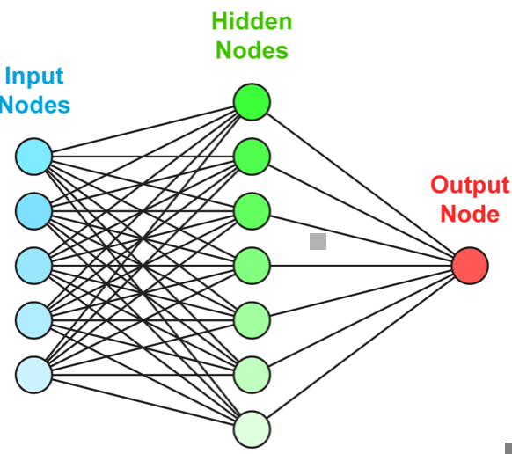
Neural Net Classifiers
Forward Propagation
weights
Optimize weights to minimize error
Back Propagation
# of output nodes equals number of classes
Linear Function
Input Data
Y=∑(W_{i *}F_{i})
Non- Linear Function σ(∑(W_{i *}F_{i}) )
Sigmoid or ReLU
Perceptron learns by adjusting weights, observation by observation (epoch)
W_{i}=weights
Feature 1
Feature 2
s
Z-target to minimize Mean Squared Error using gradient descent back propagation
Feature 3
Feature 4
Feature 5
Weights are adjusted until correct classification is achieved based upon a learning rate
Weight updates

Slide 50
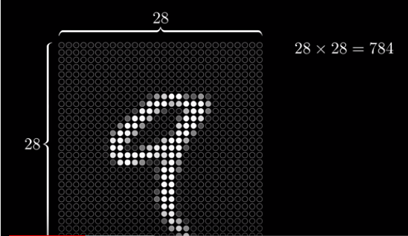

Slide 51
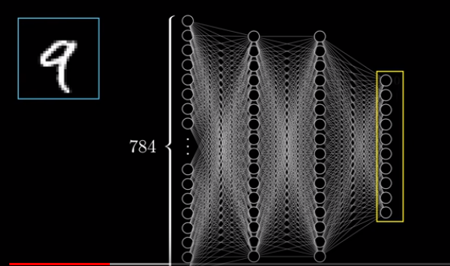

Slide 52
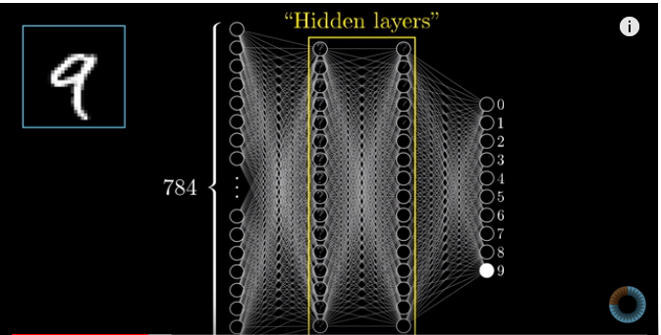
Examples Are Commonly Pattern Recognition

Slide 53

What the Hidden Layers Do

Slide 54

Weights and Bias Determine Which Actuators Receive the Highest Score Given an Unlabeled Input Image

Slide 55


Slide 56

Deep Learning Video From Rapidminer
https://www.bing.com/videos/search?q=deep+learning+rapidminer+ingo&view=detail&mid=6303EF1DA3EF0FEB15B46303EF1DA3EF0FEB15B4&FORM=VIRE

Slide 57

3BlueBrown1 Deep Learning Series of Videos
Neural Nets Basics
https://www.youtube.com/watch?v=aircAruvnKk
https://www.youtube.com/watch?v=Ilg3gGewQ5U&list=PLZHQObOWTQDNU6R1_67000Dx_ZCJB-3pi&index=4&t=0s
Back Propagation
Back Propagation Calculus
https://www.youtube.com/watch?v=tIeHLnjs5U8
Gradient Descent: How Neural Networks Learn
https://www.youtube.com/watch?v=IHZwWFHWa-w

Slide 58


Let’s Go Through Some Examples Using Rapidminer

Slide 59



Slide 60


Slide 61
Support Vector Machines—Maximum Margin Classifier
Another Pattern Recognition Family of Algorithms
X2
Many Boundaries Are Possible, Which is the Best?
B₀+B₁ X₁ +B₂ X₂=0
B₀+B₁ X₁ +B₂ X₂<0
B₀+B₁ X₁ +B₂ X₂>0
X1
Positive Outcome
Negative Outcome

Slide 62
Support Vector Machines—Outliers Require Soft (biased) Margin Classifier or SVM
X2
An interesting aspect of Kernel Methods is their ability to transform data that are inseparable in the R² space into a higher dimension where it can become easily separable with simple methods.
X1
Positive Outcome
Cost C --→tolerance for misclassifications (how much C=0 no tolerance
Negative Outcome

Slide 63

When Classes are Not Linearly Separable, We Use Non- Linear Kernals
We Transform Lower Dimensional to Higher Dimensional Space

Slide 64
Support Vector Machines—Outliers Require Soft (biased) Margin Classifier or SVM
An interesting aspect of Kernel Methods is their ability to transform data that are inseparable in the R² space into a higher dimension where it can become easily separable with simple methods.
X1
Positive Outcome
Cost C --→tolerance for misclassifications (how much C=0 no tolerance
Negative Outcome

Slide 65
X1 squared
X1
Positive Outcome
Using a Polynomial Kernel We Add a dimension and transform to squared and then carry out the Maximum Margin Classification
Negative Outcome

Slide 66

Fast Large Margin for Extremely Large datasets

Slide 67

Weights from SVMs for Dataset 4

Slide 68


Final Project Instructions

Slide 69


Slide 70

And get started on your course project
Discussion board related to question 2.

